Slide 1
EOC Course 2007
Governor’s Office of Emergency Services

Slide 2
Course Objectives
Understand essential SEMS terms and five levels of response and their relationship to the four SEMS EOC levels
Understand the principles of ICS applicable to EOCs
Understand the role of the EOC in disaster management and SEMS

Slide 3
Course Objectives
Understand the functions, responsibilities and procedures for EOCs at all SEMS levels
Understand how coordination takes place between SEMS levels during a disaster response

Slide 4
Course Overview
Chapter 1: Background on CA Emergency Management Related to EOCs
Chapter 2: Principles of Incident/Disaster Management – ICS
Chapter 3: Principles of Disaster Manegement - SEMS

Slide 5
Course Overview
Chapter 4: EOC Operational Considerations
Chapter 5: EOC Features at Each SEMS Level
Chapter 6: SEMS Function Specific Handbooks

Slide 6
Chapter 1:
Background on CA Emergency Management Relating to EOCs

Slide 7
CA Emergency Service Act
Government Code: §8550 Et. Seq.
Requires preparation for disasters
Confer emergency powers during disasters

Slide 8
Background
Senate Bill 1841 (Petris) – Government code §8607
SEMS Regulations effective 1994
SEMS required to be in place by December 1, 1996

Slide 9
Major Components of SEMS
Incident Command System
Inter-agency Coordination
Master Mutual Aid Systems
Operational Areas

Slide 10
Five SEMS Levels of Response
Field
Local Government
Operational Area
Region
State

Slide 11
Five SEMS Functions
Command (Field) – Management (EOC)
Operations
Planning/Intelligence
Logistics
Finance/Administration

Slide 12
National Incident Management System (NIMS)
Homeland Security Presidential Directive 5 directed Secretary, DHS to develop and administer:
  National Incident Management System (NIMS)
    Core set of concepts, principles and terminology for incident command and multiagency coordination
  National Response Plan (NRP)

Slide 13
National Incident Management System (NIMS)
“…a consistent nationwide approach for Federal, State, tribal and local governments to work effectively and efficiently together to prepare for, prevent, respond to and recover from domestic incidents, regardless of cause, size or complexity…”

Slide 14
NIMS Key Concepts
Flexibility
  Applicable regardless of incident cause, size, location or complexity
Standardization
  Key to interoperability
Ongoing support: NIMS Integration Center

Slide 15
NIMS Components
Command and Management
Preparedness
Resource Management
Communications and Information Management
Supporting Technologies
Ongoing Management and Maintenance

Slide 16
Command and Management
Incident Command System
Multi-agency coordination
Public Information Systems

Slide 17
Preparedness
Planning
Training and Exercises
Personnel Qualification and Certification
Equipment Acquisition and Certification
Publication Management
Mutual Aid Agreements

Slide 18
Resource Management
Advance Planning
Resource Identification and Ordering
Categorizing Resources
Use of Agreements
Effective Management of Resources
Management Information Systems
Ordering, Mobilization, Dispatching and Demobilization Protocols

Slide 19
Resource Management (con’t.)
Identifying and Typing Resources
Certifying and Credentialing Personnel
Identifying Resource Requirements and Inventorying Resources
Ordering and Acquiring Resources
Mobilizing and Tracking
Recovering Resources
Reimbursement

Slide 20
Communications and Information Management
Need for a common operating picture that is accessible across jurisdictions and agencies
Common communications and data standards are essential
NIC responsible for facilitating progress
Identifies requirements for: communications, information management, information sharing

Slide 21
Supporting Technologies
Interoperability and Compatibility
Technology Support
Technology Standards
Broad-based Requirements
Strategic Planning for Research and Development

Slide 22
Ongoing Management and Maintenance
NIC responsible for providing strategic direction for and oversight of NIMS
Includes developing a process for ongoing revisions and updates to the NIMS
Input will be encouraged from all entities

Slide 23
EOC Glossary of Terms
Emergency Operations Center:
  Location from which “Centralized Emergency Management can be performed”
Department Operations Center:
  Single discipline operations center
  May be utilized at any level above the Field Response Level

Slide 24
EOC Glossary of Terms
EOC Action Plan
  Contains the priorities and objectives to be accomplished
  Establishes timeframes for these objectives to be accomplished (operational periods)
Inter-Agency Coordination
  Agencies working together to facilitate decision-making
  Is required at all SEMS levels

Slide 25
EOC Glossary of Terms
Mutual Aid
  Sharing resources between jurisdictions based on need
  Formal mutual aid systems and agreements exist for law enforcement, fire and other disciplines

Slide 26
Chapter 2:
Principles of Disaster Management (ICS)

Slide 27
Incident Command System (ICS) Overview
EOC uses basic principles from ICS:
  5 Primary Functions
  Management by Objectives
  Unity of Command
  Span of Control
  Action Planning

Slide 28
Five Primary ICS Functions
Incident Command
Operations
Planning/Intelligence
Logistics
Finance/Administration

Slide 29
Management by Objectives
Provides structure for the EOC Action Plan
Sets strategic objectives and operational priorities
Defines authority relationships
Assists in identifying future actions and resource needs

Slide 30
Unity of Command
Management Unity is a preferred term for the EOC
Overall responsibility rests with the EOC Director
Authority may be delegated to Section Coordinators
Deactivate EOC elements not needed
EOC Director is responsible for any function not delegated

Slide 31
Span of Control
Ratio of subordinates reporting to one supervisor
3-7 is recommended
Complexity of the task at hand is a factor
Deputy positions can ease span of control problems

Slide 32
The EOC Action Plan
Purpose:
  Provides direction
  Assigns responsibility
  Instills accountability
  Measures progress
  Updated for each operational period

Slide 33
The EOC Action Plan
Plan Components:
  Heading / Event Information
  Overall Priorities
  Organizational Chart
  Functions specific objectives
  Status of completion

Slide 34
Command and General Staff
Objectives:
  Identify the design of ICS to compensate for common incident management problems
  Describe the general guidelines related to Command and General Staff positions
  Summarize responsibilities for each Command and General Staff member

Slide 35
Command and General Staff
Objectives (con’t.):
  Describe the roles of deputies and assistants in incident management
  Describe the purposes and responsibilities of agency representatives, reporting relationships and their effective use

Slide 36
Command and General Staff Functions
Delegate authority
Provide logistical support
Provide planning services
Provide for administrative and cost control
Provide information services
Ensure a safe operating environment
Interact effectively with other agencies

Slide 37
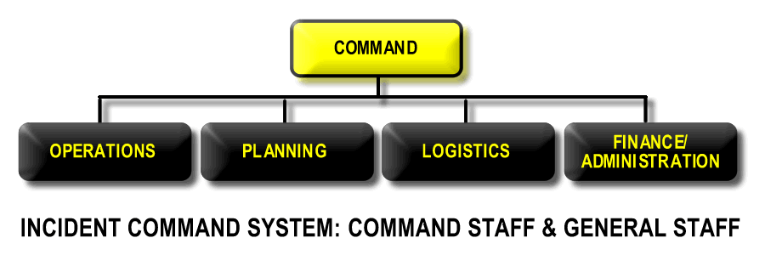
Incident Command System
Command
Command
Command Staff
Command Staff
General Staff
General Staff

Slide 38
Incident Commander Responsibilities
Ensure your clear authority and know agency policy
Ensure incident safety
Establish an Incident Command Post
Obtain a briefing form the prior Incident Commander and/or assess the situation
Establish immediate priorities

Slide 39
Incident Commander Responsibilities
Determine incident objectives and strategy(s) to be followed
Establish the level of organization needed and continuously monitor the operation and effectiveness of that organization
Manage planning meetings as required
Approve and implement the Incident Action Plan

Slide 40
Incident Commander Responsibilities
Coordinate the activities of the Command and General Staff
Approve requests for additional resources or for the release of resources
Approve the use of students, volunteers and auxiliary personnel
Authorize the release of information to the news media

Slide 41
Incident Commander Responsibilities
Order demobilization of the incident when appropriate
Ensure incident after-action reports are complete

Slide 42
ICS Command Staff Positions
Information Officer
Safety Officer
Liaison Officer
  Agency Representatives

Slide 43
Information Officer
Responsibilities:
  Develops information for use in press/media briefings
  Obtains IC’s approval of media news releases
  Conducts periodic media briefings
  Arranges for tours and other interviews or briefings that may be required

Slide 44
Information Officer
Responsibilities (con’t.):
  Monitors and forwards media information that may be useful to incident planning
  Maintains current information summaries and/or displays on the incident
  Makes information about the incident available to incident personnel
  Participates in the planning meeting

Slide 45
Safety Officer
Responsibilities:
  Monitors for hazardous situations
  Develops safety procedures and Safety Plan
  Has authority to stop unsafe acts
  Reviews the Incident Action Plan for safety implications

Slide 46
Safety Officer
Responsibilities (con’t):
  Initiates preliminary investigation of accidents within the incident area
  Reviews and approves the medical plan
  Ensures safety messages and briefings are made
  Participates in planning meetings

Slide 47
Liaison Officer
Responsibilities:
  Acts as a point of contact for Agency Representatives
  Maintains a list of assisting and cooperating agencies and Agency Representatives
  Assists in setting up and coordinating interagency contacts
  Monitors incident operations to identify current or potential inter-organizational problems

Slide 48
Liaison Officer
Responsibilities (con’t.):
  Participates in planning meetings, providing current resource status, including limitations and capability of agency resources
  Provides agency-specific demobilization information and requirements

Slide 49
Agency Representatives
Responsibilities:
  Ensures that all agency resources have checked-in
  Obtains briefing from the Liaison Officer or Incident Commander upon arrival and debriefs prior to departure
  Informs agency personnel on the incident that the Agency Representative position has been filled

Slide 50
Agency Representatives
Responsibilities (con’t.):
  Provides input on use of agency resources
  Oversees the well-being and safety of agency personnel
  Ensures that all agency personnel and equipment are properly accounted for and released prior to departure
  Ensures that all required agency forms, reports and documents are complete

Slide 51
Guidelines for Command Staff
Only one person will be designated for each of the Command Staff positions
Command Staff positions should not be combined
Command Staff positions may be filled by persons from other agencies or jurisdictions
There are no deputy positions at the Command Staff level
Each of the positions may have one or more assistants as necessary

Slide 52
Guidelines for Command Staff (con’t.)
Assistants are recommended for larger incidents
Assistants can be designated from other jurisdictions or agencies as appropriate
Command Staff members report directly ot the Incident Commander
Command Staff members may interact with any position within the ICS for purposes of information exchange

Slide 53
ICS General Staff Positions
Operations Section Chief
Planning Section Chief
Logistics Section Chief
Finance/Administration Section Chief
Command
Command Staff
General Staff

Slide 54
Guidelines for General Staff
Only one person will be designated to lead each General Staff position
General Staff positions may be filled by qualified persons from any agency or jurisdiction
Each member of the General Staff reports directly to the Incident Commander

Slide 55
Guidelines for General Staff
Deputy positions may be established for each of the General Staff positions. Deputies can be designated from other agencies as appropriate.
General Staff members may exchange information with any person within the organization through the chain of command
General Staff positions (i.e. sections) should not be combined.

Slide 56
Incident Management
Use ICS for events
  Organizing for a major field training exercise or simulated emergency
  A planned public even such as a major parade or concert
  A planned activity such as a prescribed fire, a low enforcement sweep, a major pest control effort or a marine hazardous materials exercise

Slide 57
Event Planning Considerations
Type of incident/event?
Location, size, duration?
Single or multi-agency?
Single or multi-jurisdiction?
Command staff needs?
Kind, type, number of resources?
Air Operations involved?

Slide 58
More Event Planning Considerations
Staging Areas required?
Other facilities required?
Logistical support needs?
Any limitations and/or restrictions?
Available communications?

Slide 59
Considerations for Unplanned Incidents
An incident occurs
Time is of the essence
The situation is unstable
Potential to expand communications and information may be incomplete
Staff not necessarily experienced in managing expanding incidents

Slide 60
Initial Steps in Organizing Incidents
Size up the situation
Determine if there are lives at immediate risk
Establish the immediate objectives
Determine if there are enough and the right kind of resources on scene and/or ordered
Develop an action plan
Establish an early organization

Slide 61
Initial Steps in Organizing Incidents (con’t.)
Consider if span of control is or will soon approach practical limits
Ensure that personnel safety factors are taken into account
Determine if there are any environmental issues that need to be considered
Monitor the work progress
Review and modify objectives and action plan as necessary

Slide 62
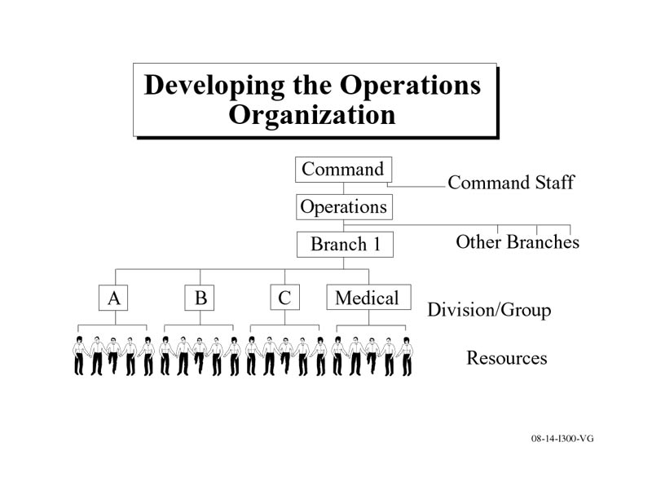

Slide 63
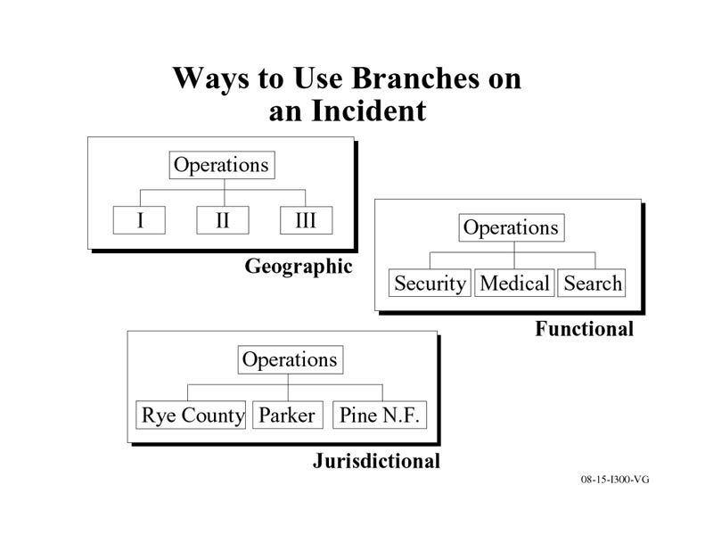

Slide 64
Unified Command
Definition:
  A team effort which allows all agencies with responsibility for the incident to jointly provide management direction to an incident through a common set of incident objectives and strategies established at the command level.

Slide 65
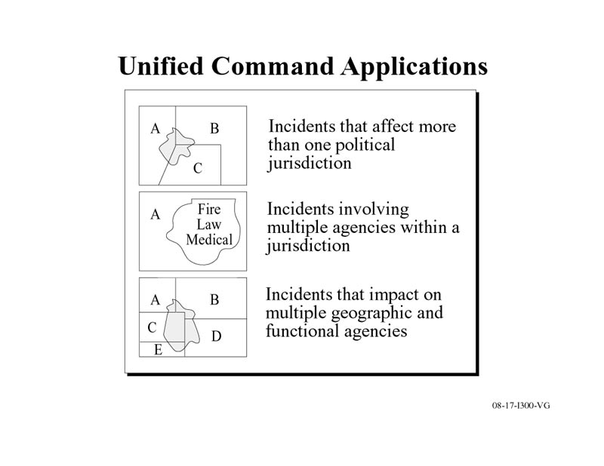

Slide 66
Advantages of using Unified Command
One set of objectives is developed for the entire incident, and a collective approach is made to developing strategies
Information flow and coordination is improved between all jurisdictions and agencies involved in the incident
No agency’s authority or legal requirements will be compromised or neglected

Slide 67
Advantages of using Unified Command (con’t.)
Each agency is fully aware of the plans, actions and constraints of all others
The combined efforts of all agencies is optimized as they perform their respective assignments under a single Incident Action Plan
Duplicative efforts are reduced or eliminated, thus reducing the cost and chances for frustration and conflict

Slide 68
Under Unified Command there is:
A single integrated incident organization
One Operations Section Chief to direct tactical efforts
Collocated (shared) facilities
A single integrated planning process and Incident Action Plan
Shared planning, logistical and finance/administration operations wherever possible
A coordinated process for resource ordering

Slide 69
Guidelines for Staffing the ICS Organization
Deputies may be used for Command, General and Branch staff
Command staff may have assistants
Multi-jurisdictional incidents should establish an Unified Command
Expand the organization as needed

Slide 70
Planning Exercise
The planned event – Riverdale Centennial Celebration
What you are to do:
  Produce the Incident Objectives
  The organization to cover the afternoon and evening for the event
  Recommendations for staff sizes for the various units within the organization

Slide 71
Things to keep in mind…
Are the objectives clearly stated and measurable?
Does the makeup of the operations organization generally support the strategy?
Are necessary General Staff positions filled?
Are staff sizes adequate?

Slide 72
Things to keep in mind…
Has the need for Command Staff positions been considered?
Is span of control adequate?
If you were the incoming Incident Commander, would you accept this organization and staff sizes?

Slide 73
Area Command
Definition:
An organization established to:
  Oversee the management of multiple incidents that are each being handled by an Incident Command System organization; or
  Oversee the management of a very large incident that has multiple Incident Management Teams assigned to it.

Slide 74
Area Command Responsibilities
Set overall agency incident-related priorities
Allocate critical resources based on priorities
Ensure that incidents are properly managed
Ensure that incident(s) objectives are met and do not conflict with each other or with agency policy

Slide 75
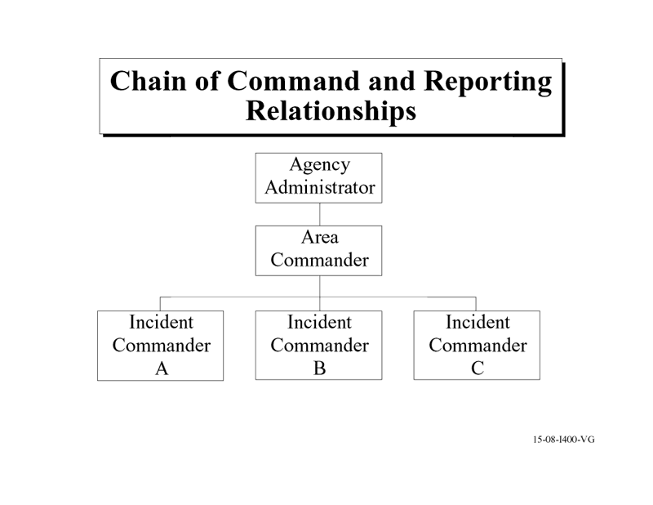

Slide 76
Reasons to use Area Command
Allows incident management teams to focus attention on assigned incidents
Area command sets priorities and allocates critical resources
Ensures agency policies, priorities, constraints and guidance are being made known to the respective ICs
Reduces workload of the Agency Executive

Slide 77
Establishing an Area Command
When do you establish an Area Command? When:
  Several active incidents are in close proximity
  Critical human or property values are at risk due to incidents
  Incidents will continue into the next operational period
  Incidents are using similar and limited critical resources
  Difficulties are encountered with inter-incident resource allocation and coordination

Slide 78
Establishing an Area Command (con’t.)
How is an Area Command established?
  By the Agency Executive
  Given written delegated authority
  Has best-qualified, experienced personnel
  Patterned after ICS Command/General Staff
  Operates under same principles as ICS
  Organization should be kept small

Slide 79
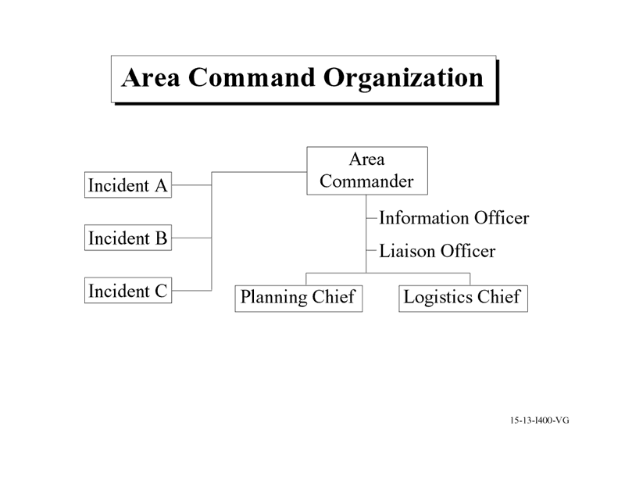

Slide 80
Primary Functions of an Area Command
Provide agency or jurisdictional authority for assigned incidents
Ensure a clear understanding of agency expectations, intentions and constraints
Establish critical resource use priorities between various incidents

Slide 81
Primary Functions of an Area Command (con’t.)
Ensure that incident management team personnel assignments and organizations are appropriate
Maintain contact with officials in charge, other agencies and groups
Coordinated the demobilization or reassignment of resources between assigned incidents

Slide 82
Multi-Agency Coordination System (MACS)
Where MACS is currently accomplished:
  At the scene of the incident
  At an Area Command
  At a jurisdiction’s Emergency Operations Center (EOC)
  At an interjurisdictional or regional level
  At state and federal levels
  Internationally

Slide 83
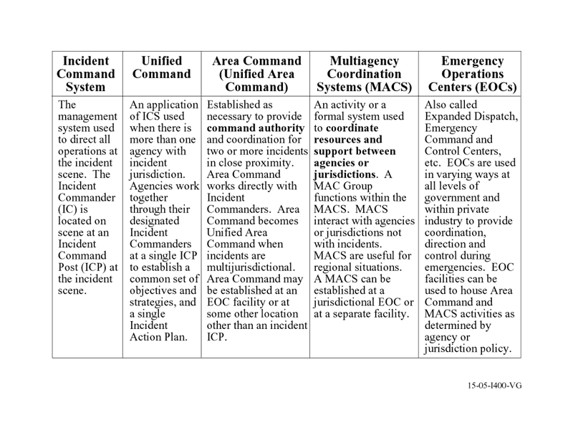
Keeping it all straight!

Slide 84
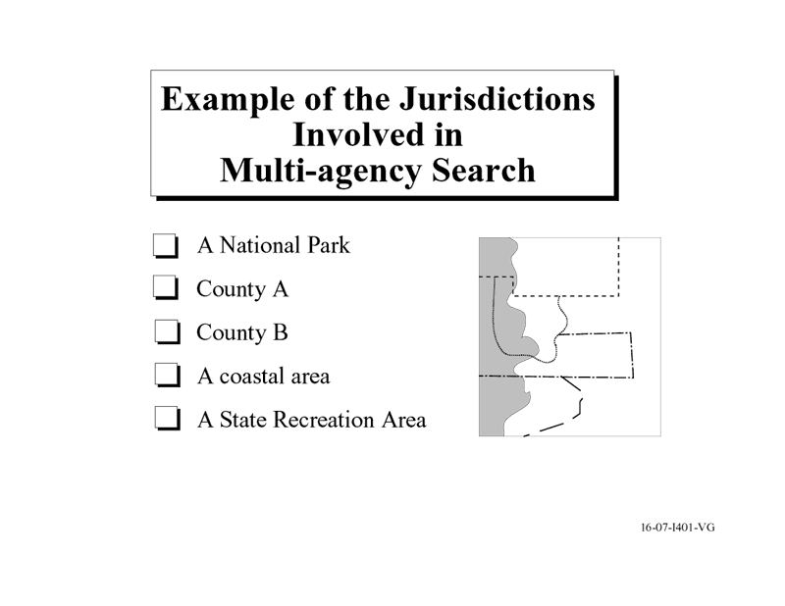

Slide 85
Defining in Intergovernmental MACS
Incident priority determination
Critical resource use priorities
Communications systems integration
Information coordination
Intergovernmental decision coordination

Slide 86
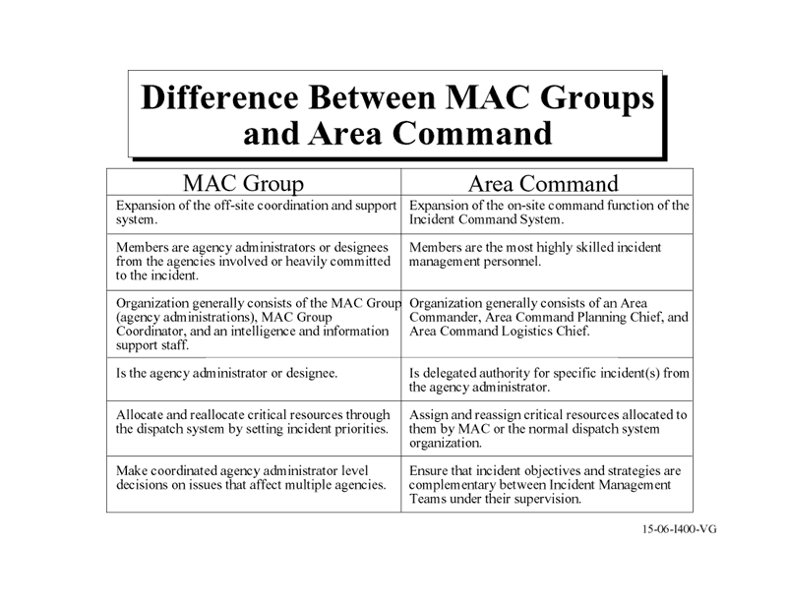

Slide 87
Primary Functions of MACS
Incident priority determination
Critical resource use priorities
Communications systems integration
Information coordination
Intergovernmental decision coordination

Slide 88
ICS as the EOC or MACS Model
Five primary functions of ICS are appropriate at EOCs
Duplication of terminology could create confusion
  Example: EOC – Incident Commander
  Incident – Incident Commander
Best to vary the position titles to avoid confusion
EOC sub-functions should be based on the operational need

Slide 89
Resource Management
The Incident Resource Management Process:
  Establishing Resource Needs
  Resource Ordering
  Check-in Process
  Resource Utilization and Evaluation
  Resource Demobilization

Slide 90
What is a “resource”?
Personnel resources
  People who are assigned to functional areas within ICS sections based on experience, training, and past performance
Equipment resources
  Both the equipment and the personnel to operate the equipment. This includes aviation resources

Slide 91
Establishing Resource Needs
Why is this important?
  Assists in establishing resource needs for an operational period
  Communicates the decisions made during the tactics meeting
  Provides information that is used for ordering resources for the incident

Slide 92
Resource Kinds and Typing
Kinds of Resources:
  Describe what the resource is, i.e. medic, firefighter, Planning Sections Chief, ambulance
Types of Resources:
  Describe the size, capability and staffing qualifications of a specific kind of resource
  Examples?

Slide 93
Resource Ordering
Who does what?
  Command develops incident objectives and approves resource orders and demobilization.
  Operations identifies, assigns, and supervises the resources needed to accomplish the incident objectives.
  Planning tracks resources and identifies resource shortages.
  Logistics orders resources.
  Finance and Administration procures and pays for the resources and reports costs.

Slide 94
Essential Information for any Resource Order
Incident name
Order and/or request number
Date and time of order
Quantity, kind, type of resources
Reporting location
Requested arrival time
Radio frequency
Person/title placing request
Call-back number or ratio designation for clarification

Slide 95
Resource Check-in Process
Five possible check-in locations:
  Incident Base
  Camp
  Staging Area
  Resource Unit at the Incident Command Post

Slide 96
Information to give at Check-in
Date and time of check-in
Name of the resource
Home base
Departure point
Order number and position filled (personnel only)

Slide 97
Information to give at Check-in (con’t.)
Crew Leader name and personnel manifest (for crews)
Other qualifications
Travel method
Mobilization authorization (if appropriate)

Slide 98
Tracking Resources
Responsibility is shared between:
  Planning Section
  Operations Section

Slide 99
Resource Status
Assigned – Currently working on an assignment under the direction of a supervisor
Available – Ready for immediate assignment and has been issued all required equipment
Out-of-Service – Not available or ready to be assigned (e.g., maintenance issues, rest period)

Slide 100
Resource Utilization and Evaluation
Resource Assignment: Primary and tactical resources will initially be assigned to one of these locations:
  Direct assignment to supervisor
  Staging Area
  Incident Base or Camp

Slide 101
Resource Evaluation
Resources should be evaluated:
  On an ongoing basis as part of resource monitoring
  At demobilization, up the achievement of the objectives
  During after-action reporting

Slide 102
Resource Demobilization
Demobilization Plan should contain:
  General information (guidelines)
  Responsibilities
  Release priorities
  Release procedures
  Directory (maps, phone listings, etc.)

Slide 103
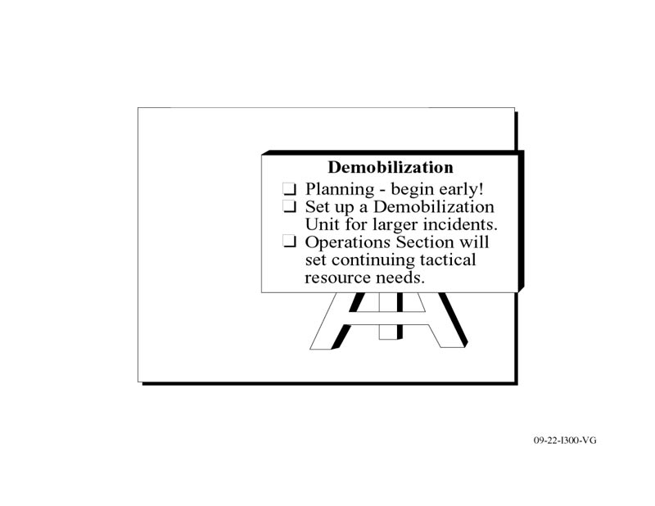
Resource Demobilization (con’t.)

Slide 104
Key Resource Management Considerations
Safety
Personnel Accountability
Managerial control
Adequate reserves
Cost

Slide 105
Chapter 3:
Principles of Disaster Management (SEMS)

Slide 106
Incident vs. Disaster
Incident Characteristics
  Usually a single event – may be small or large.
  Has a defined geographical area.
  Will use local resources and mutual aid may be applied.
  Usually only one or a few agencies involved.
  Ordinary threat to life and/or property – limited population and geographic area.

Slide 107
Incident vs. Disaster (con’t.)
Incident Characteristics (con’t.):
  Usually a local emergency will not be declared and jurisdictional EOC will not be activated for a single or multiple small incidents.
  Usually a fairly short duration measured in hours or a few days.
  Primary command decisions are made at the scene Incident Command Post(s).
  Strategy, tactics and resource assignments are determined on scene.

Slide 108
Incident vs. Disaster (con’t.)
Disaster Characteristics:
  Single or multiple events (can have many separate incidents associated with it).
  Resource demand is beyond local capabilities and extensive mutual aid and support needed.
  Many agencies and jurisdictions involved (multiple layers of government).
  Extraordinary threat to life and/or property.

Slide 109
Incident vs. Disaster (con’t.)
Disaster Characteristics (con’t.):
  Generally a widespread population and geographic area affected.
  Will last over a substantial period of time (days to weeks) and local government will proclaim a Local Emergency.
  Emergency Operations Centers are activated to provide centralized overall coordination of jurisdiction assets, department and incident support functions, and initial recovery operations.

Slide 110
Challenge of Managing Disasters
Focus on your experiences with disaster management
What went right?
What went wrong?

Slide 111
Common Goals of Incident and Disaster Management
Save lives
Care of casualties
Limit further threats to life, property or the environment
Reassure and care for the public
Restore the affected area to normal

Slide 112
Phases of Emergency Management
Pre-Emergency
  Mitigation
  Preparedness
Emergency
  Response
Post-Emergency
  Recovery

Slide 113
Phases of Emergency Management (con’t.)
Mitigation
  Steps taken to reduce the potential harm from a foreseeable event
  Examples include:
    Retrofitting buildings or facilities
    Abating hazards
    Restrictive land use ordinances

Slide 114
Phases of Emergency Management (con’t.)
Preparedness
  Steps taken to prepare people and organizations to respond to disasters
  Examples:
    Training and Exercises
    Planning
    Resource acquisition

Slide 115
Phases of Emergency Management (con’t.)
Response
  Actions taken in direct response to a disaster
  Examples:
    Rescues and evacuations
    Containment of hazardous spills
    Care and shelter of affected populations

Slide 116
Phases of Emergency Management (con’t.)
Recovery
  Actions necessary to return the affected are to normal
  Planning for recovery begins during the response phase
  Examples???

Slide 117
EOC During the Pre-Emergency Phase
EOC develops plans, procedures and protocols
EOC addresses facility and resource needs
EOC trains and prepares its staff

Slide 118
EOC During the Emergency Phase
EOC provides “centralized coordination” for the overall emergency response

Slide 119
EOC During the Post-Emergency Phase
EOC can be utilized to direct and coordinate the overall recovery operation

Slide 120
Emergency Management Process
Planning
Organizing
Leading
Evaluating
Improving

Slide 121
Management Process Principles Defined
Planning
  Activity taken in advance to ensure an effective operation
Organizing
  Ensuring that assignments are known and understood
  Ensuring that systems and procedures are in place

Slide 122
Management Process Principles Defined (con’t.)
Leading
  Coordinating, communicating, guiding, supervision, motivation
  Delegation of authority
    Uses the skills and talents of others
    Minimizes delays in completing tasks
    Facilitates staff development
    Provides a more meaningful work environment

Slide 123
Management Process Principles Defined (con’t.)
Evaluating
  A dynamic process
  EOC Action Planning Objectives are used to evaluate EOC effectiveness
Improving
  Based on an objective analysis of evaluation
  Developing and implementing changes relative to people, facilities and resources

Slide 124
Keys to Effective Emergency Management
Delegation
Clearly defined reporting relationships
Disaster Plan in place
SOPs and checklists
Staff training and exercises
Use of SEMS
Well-designed and equipped EOC

Slide 125
Chapter 4:
EOC Operational Considerations

Slide 126
The Emergency Operations Center (EOC)
Design Considerations
Effective utilization
Activation criteria
Mutual Aid Relationships

Slide 127
EOC Design Considerations
No established design standards
Good design will enhance the effectiveness of the EOC
Things to consider
  SEMS functional relationships?
  Number of staff required?
  Facility size, location, condition?
  Auxiliary power supply?
  Other considerations?

Slide 128
Activation Guidelines
Some basic considerations:
  Nature, scope and duration of the emergency
  Have other EOCs activated and at what level?
  What SEMS functions will be needed to support the overall response?

Slide 129
Activation Levels
Level 1 – Minimum Activation
  EOC Director, Section Coordinators, Situation Assessment Unit
Level 2
  May be tailored to a specific event
  Five SEMS functions as needed

Slide 130
Activation Levels (con’t.)
Level 3 – Full Activation
  Full staffing
  Agency representatives
  Usually in response to a major emergency

Slide 131
EOC Operating Requirements
EOC to be activated for any major emergency or even requiring two or more departmental operations
EOC must be able to be activated within one hour
Staff access to EOC must be assured
Internal EOC operations to follow the five SEMS functions (Management, Operations, Planning/Intelligence, Logistics, Finance/Admin

Slide 132
EOC Operating Requirements (con’t.)
Must be able to accommodate other agency representatives
EOC will not provide tactical direction to the field
Assist in the coordination and allocation of resources between departments and ordering of out-of-jurisdiction resources

Slide 133
EOC Operating Requirements (con’t.)
Functional work stations with the capability to communicate directly with DOCs or field command posts
Primary point for developing situation and damage assessment information
Coordinate damage assessment and recovery activities

Slide 134
Inter-Agency Coordination
Communication, Coordination and Cooperation!
Between:
    Disciplines
    Jurisdictions
    Different levels of government

Slide 135
Inter-Agency Groups and the EOC
Agency representatives who have a vested interest in the response
Can provide information and insight for prudent decision-making

Slide 136
Mutual Aid in the EOC
Formal Mutual Aid Systems in California:
  Fire and Rescue
  Law Enforcement
  Medical/Health
  Emergency Services

Slide 137
Mutual Aid in the EOC
May operate outside the EOC through formal mutual aid channels, or
May be coordinated through the EOC
EOC must be kept informed of mutual aid status

Slide 138
Chapter 5:
EOC Features at
Each SEMS Level

Slide 139
Chapter Overview
This chapter is subdivided into four sections
Each section describes both common and varying features of EOCs and the following SEMS levels:
  Local Government
  Operational Area
  Region
  State

Slide 140
EOCs at each SEMS Level of Response
State EOC (SOC)
Region EOC (REOC)
Operational Area EOC
Local Governmnt EOC
Field ICP

Slide 141
Local Government EOC
Local governments are:
  Cities, counties and special districts
What does the Local Government EOC do?
  Centralized Emergency Management
  Serves the need of the jurisdiction or special district
  Coordinates with other governments and the Operational Area EOC

Slide 142
To Comply with SEMS…
Local Government EOCs must:
  Use all SEMS functions as needed
  Comply with SEMS regulations
  Use existing fire and law enforcement mutual aid systems
  Practice inter-agency coordination
  Establish communication with the field level and DOCs (if used)

Slide 143
Role of the Department Operations Center (DOC)
Facility used by a single discipline (i.e. Department of Motor Vehicles)
Manages the field response for that discipline only
Coordinates with the jurisdiction’s EOC

Slide 144
Five SEMS Functions in the Local Government EOC
Management
  Establishes overall policy and determines operational priorities
Operations
  Implements the EOC Action Plan

Slide 145
Five SEMS Functions in the Local Government EOC (con’t.)
Planning/Intelligence
  Collects, analyzes and distributes information
  Facilitates the Action Planning Process
  Develops and distributes the EOC Action Plan
Logistics
  Provides supplies, services, personnel, facilities and equipment, in support of the response

Slide 146
Five SEMS Functions in the Local Government EOC (con’t.)
Finance/Administration
  Provides for time-keeping, cost accounting and financial record-keeping during the response
  Oversees fiscal recovery activities

Slide 147
Organizing Staff Within the EOC
Effectively promotes:
  Efficient tasking
  Proper span of control
  Appropriate lines of authority
Recommended Hierarchy:
  Section
  Branch
  Group
  Unit

Slide 148
Organization Functions in the EOC
Slide 13

Slide 149
EOC Staffing Progression
Activation/Initial Operational Period
  EOC Director, Section Coordinators as needed
  Information gathering
  Further determination of staffing needs
  Initial support to field elements

Slide 150
EOC Staffing Progression (con’t.)
Second Operational Period
  Additional Management Staff as needed
  Branches / Unties established in Operations, Planning/Intelligence and Logistics
  Cost / Time-keeping Units established in Finance/Administration

Slide 151
EOC Staffing Progression (con’t.)
Sustained Periods
  All SEMS functions staffed as required
  Relief schedules maintained
Demobilization
  Determined by field support needs
  “Response Operations” diminish
  “Recovery Operations” intensifies
  Finance/Administration function enlarges and intensifies

Slide 152
Role of the EOC Director
Overall responsibility for accomplishing the EOC mission
Overall authority to manage the emergency response
Is accountable to policy executives

Slide 153
Role of General Staff
(Section Coordinators)
Provide direct oversight for all section staff
Responsible for completing Action Plan goals and objectives
Must promote interagency coordination

Slide 154
Inter-agency Coordination Means Working Together to…
Establish response priorities
Facilitate effective communication
Allocate resources
Develop strategies
Share information

Slide 155
Special District EOC
Special Districts are defined as “local governments” in SEMS
Priority is to restore Special District services or operations to normal
Coordinates with other local government EOCS

Slide 156
Special District Coordination
Special District Serves #1 Jurisdiction
  Provides an agency representative in the jurisdiction’s EOC
Special District Serves Multiple Jurisdictions
  Provides agency representatives to each jurisdiction, or…
  Provides one agency representative at the Operational Area EOC

Slide 157
Other ways to Coordinate with Special Districts?
How does your jurisdiction or district promote and maintain inter-agency coordination?

Slide 158
Coordinating with Community Based Organizations
Organizations that have a key role in response operations should be represented in the Local Government EOC
If the organization serves the entire county, they should be represented at the Operational Area EOC

Slide 159
Mutual Aid Systems in the EOC
Mutual Aid Systems may be coordinated at the EOC
If not coordinated at the EOC, mutual aid status and information should be available through Branch Coordinators in Operations
Resources not available through mutual aid channels may be ordered through the EOC Logistics Section

Slide 160
Coordination Between SEMS Levels is Essential
For effective response
For rapid mobilization
To effectively allocate resources

Slide 161
EOC Coordination with Field Incident Commands
When Local Government EOCs are activated, communication and coordination with the field must be established and maintained
Policy authority remains at the EOC
Authority to implement agency policy can be delegated to Incident Commanders in the field

Slide 162
Single Discipline / Jurisdiction Linkages; EOC to Field

Slide 163
EOC Coordination with Unified Commands
Involved agencies form a Unified Command
Operate from a single command post
Utilize a single Incident Action Plan
Typically have a single Operations Chief

Slide 164
Multiple Disciplines / Unified Command Linkages with EOC

Slide 165
Multiple Incidents /
Single Jurisdiction

Slide 166
Multiple Incidents /
Single Jurisdiction

Slide 167
EOC and Area Command
Area Command can provide oversight for multiple incidents being managed by individual Incident Command organizations
This generally occurs in larger jurisdictions where span of control and resource management can be problematic
Area Command does not replace the EOC
The EOC retains policy authority

Slide 168
EOC / Area Command Relationship

Slide 169
What happens when more than one jurisdiction is involved?
It is recommended that multiple jurisdictions responding to the same incident form a Unified Command or Unified Area Command
Unified Command facilitates inter-agency coordination ant the filed level
Jurisdictions must coordinate directly with their respective EOCs

Slide 170
Multiple Jurisdiction Incident Response and the EOC

Slide 171
Multiple Jurisdiction Incident Response and the EOC

Slide 172
Interaction Between Levels and Functions

Slide 173
Organizational Interaction

Slide 174
ICS – Local EOC:
Functional Interaction

Slide 175
Operational Area EOC
Operational Areas are:
  Counties
  All political subdivisions within the county

Slide 176
Operational Area EOCs:
Must use all SEMS functions as needed
Must comply with SEMS regulations
Must use existing fire and law enforcement mutual aid systems
Must practice inter-agency coordination
Must establish communication with Local Government EOCs when activated

Slide 177
What does the Operational Area EOC do?
Promotes centralized emergency management
Facilitates inter-agency coordination among all local governments in the Operational Area
Link between Local Governmetn and the OES region

Slide 178
The Operational Area Must Also:
Organize and maintain the Operational Area
Assume the responsibility as the lead agency
Activate the Operational Area as required

Slide 179
Activation Criteria:
Local Government EOC is activated and requests Operational Area activation
Two or more cities have proclaimed a local emergency
County and at least one other city has proclaimed an emergency
A Governor’s Proclamation has been requested

Slide 180
Activation Criteria (con’t.):
A Gubernatorial Proclamation is obtained for the county or two or more cities
Operational Area requests resources from outside its boundaries**
**Exception: Resources are processed through Mutual Aid Systems

Slide 181
Five SEMS Functions in the Operational Area EOC
Management
  Overall Policy Coordination
Operations
  Support Local Government Response
  Facilitate Inter-agency Coordination
  Implement EOC Action Plan

Slide 182
Five SEMS Functions in the Operational Area EOC (con’t.)
Planning/Intelligence
  Collect, analyze, disseminate information
  Develop the EOC Action Plan
Logistics
  Resource support
Finance/Administration
  Fiscal tracking

Slide 183
Who staffs the Operational Area EOC?
Lead agency staff for each SEMS function
Agency representatives
OES region field reps
Mutual Aid Coordinators
Others as needed

Slide 184
Organizing Staff within the EOC
Organizing staff effectively promotes:
  Efficient tasking
  Proper span of control
  Appropriate lines of authority
Recommended hierarchy:
  Section
  Branch
  Group
  Unit

Slide 185
Operational Area EOC
SEMS Organization Chart
EOC Director
Operations Section
Planning/
Intelligence Section
Logistics Section
Finance/ Administration Section

Slide 186
Role of the General Staff
EOC Director and Section Coordinators:
  Provide direct oversight for all SEMS functions
  Responsible for completing Action Plan goals and objectives
  Must promote interagency coordination

Slide 187
Mutual Aid Systems in the EOC
Mutual Aid Systems may be coordinated at the EOC
If not coordinated at the EOC, mutual aid status and information should be available through Branch Coordinators in Operations
Resources not available through mutual aid channels may be ordered through the EOC Logistics section

Slide 188
Inter-agency Coordination Means Working Together to:
Establish response priorities
Facilitate effective communications
Allocate resources
Develop strategies
Share information

Slide 189
Coordinating with Community Based Organizations
Organizations that have a key role in response operations should be represented in the Local Government EOC
If the organization serves the entire county, they should be represented at the Operational Area EOC

Slide 190
Response Information Management System (RIMS)
Information system that links all Operational Areas, OES Regions and State OES
Information sharing relative to:
  Situation reports
  Resource/Mission requests
  Emergency information

Slide 191
Communicating with the Local Government EOC
The Operational Area EOC must establish communication with any activated Local Government EOC

Slide 192
Policy / Coordination Relationships

Slide 193
Agency Representatives and Inter-agency Groups
Inter-agency Groups are formed at the Operational Area as required
Agency Representatives should have operational decision-making authority
Agencies represented:
  County
  Affected Cities
  Involved Special Districts
  Other organizations as required

Slide 194
Special District Coordination
When a Special District serves only one jurisdiction:
  Special District provides an agency representative in the jurisdiction’s EOC
When a Special District serves multiple jurisdiction:
  Special District provides agency representatives to each jurisdiction, or…
  Provides one agency representative at the Operational Area EOC

Slide 195
Other Ways to Coordinate with Special Districts?
How does your jurisdiction or district promote and maintain inter-agency coordination?

Slide 196
Regional EOCs (REOCs)
Three OES Administrative Regions and REOCs:
  Southern (Los Alamitos AFRC)
  Coastal (Oakland)
  Inland (Mather)

Slide 197
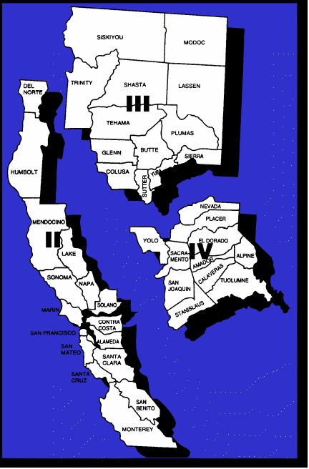
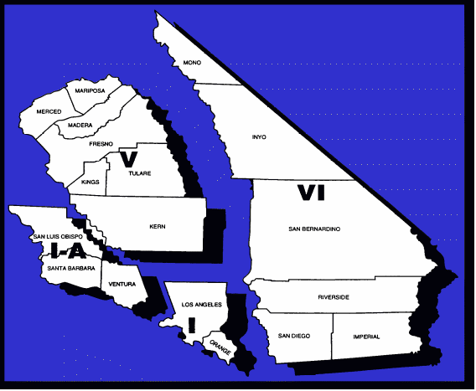
OES vs. Mutual Aid Regions
To facilitate Mutual Aid, the state is geographically divided into six (6) mutual aid regions.
Each Mutual Aid
Region has a Regional Coordinator and a State OES Coordinator

Slide 198
What does the REOC do?
Coordinates and communicate with and between the State Operations Center (SOC) and Operational Areas within the Region
Provides direct mission an resource support to Operational Areas as required
Coordinates mission requests and response activities with State Agency Department Operations Centers

Slide 199
REOC Operational Responsibilities
State’s primary link with Operational Areas
Coordinates Disaster Response of State and Federal agencies, in support of Local Governments
Provides Operational guidance to Local Governments as needed during the emergency
Assists Local Jurisdictions with the recovery process

Slide 200
REOC Activation Criteria
Within 1 hour of the activation of an Operational Area in the Region
At the direction of the Regional Administrator
Event occurs resulting in a local proclamation of an emergency

Slide 201
REOC Purchasing Authority
SOC delegates authority to the REOC Director
REOC Director provides oversight for purchasing activities assigned to Finance Administration

Slide 202
Mission Numbers
Authorize expenses associated with the use of State agency resources
REOC Director oversees Mission Assignment / Authorization process

Slide 203
Procurement Policy
Life-, safety- or time-critical situations:
  Resources procured from the NEAREST AVAILABLE SOURCE!
Non-critical procurement priority:
  Utilize State-owned resources first
  Donated goods/services
  Lease or purchased goods or services

Slide 204
5 SEMS Functions in the REOC
Management
Operations
Planning/Intelligence
Logistics
Finance/Administration

Slide 206
REOC SEMS Organization Chart
REOC Director
Operations Section
Planning/
Intelligence Section
Logistics Section
Finance/ Administration Section

Slide 207
Management
REOC Director implements OES Policy within the Region. Oversees joint efforts of all agencies at the REOC
Public Information Team develops media releases in coordination with the SOC
Liaison Officer ensures adequate support for agency representatives responding to the REOC

Slide 208
Operations
Coordination of branches within the Section that are activated in support of Operational Areas

Slide 209
Planning / Intelligence
Collects, analyzes and disseminates information
Develops REOC Action Plan with other sections
Develops Situation Reports
Documentation

Slide 210
Logistics
Procures / Provides:
  Facilities
  Services
  Personnel
  Equipment / Supplies

Slide 211
Finance / Administration
Purchasing
Cost Accounting
Time
Compensation and Claims
DSR Record-keeping

Slide 212
Levels of Activation
Activate what is needed, but remember…
If position is not activated, responsibility to “get the job done” rests with the next position above in the organization

Slide 213
Staffing Guidelines
Be aware of Span of Control issues
  1-3 ratio: Consider consolidating duties
  1-7+ ratio: Consider activating more elements
One person may fill multiple positions, however… SEMS Functions should NOT be combined!

Slide 214
Role of the General Staff
(REOC Director and Section Coordinators)
Provide direct oversight for all SEMS functions
Responsible for completing Action Plan goals and objectives
Must promote inter-agency coordination

Slide 215
Mutual Aid Systems and the REOC
Regional Mutual Aid Coordinators are not located at the REOC
Regional Mutual Aid Coordinators share information with the REOC, through branches in Operations
Branch Coordinators at the REOC can assist with the Mutual Aid response
Open communication between REOC Director and Mutual Aid Coordinators is vital

Slide 216
Resource Requests
Is the resource available within the Operational Area?
Is resource available through Mutual Aid?
If not, REOC Logistics can assist with procurement

Slide 217
REOC / Operational Area Coordination
REOC Field Representative at Operational Area EOC
Operational Area Representative at the REOC
Telecommunication Links

Slide 218
Policy / Coordination Relationships

Slide 219


OES State Operations Center (SOC)
OES State Operations Center:
3650 Schriever Avenue
Mather, CA 95655

Slide 220
What is the role of the State Operations Center?
Overall State Coordinator for statewide disasters involving multiple REOC activation
Mission number / purchasing responsibility until appropriate REOCs are activated

Slide 221
Additional Responsibilities
Ongoing coordination with State Agency Department Operations Centers
Assists REOCs with Mutual Aid issues as required
Overall coordination with Federal agencies
Coordination of statewide public information
Assist with State agency recovery efforts

Slide 222
SOC Activation Criteria
Upon activation of any REOC
Gubernatorial Proclamation of a “State of Emergency”
Earthquake or volcanic eruption prediction

Slide 223
SOC Activation
Upon activation, the SOC establishes communication with:
  Activated REOCs
  State Agency DOCs
  Federal Agencies involved in the response

Slide 224
SOC Activation (con’t.)
SOC activation levels depend on:
  Nature, scope and duration of emergency
  Degree of activation at the Region level
  Degree of REOC support required

Slide 225
SOC Organization
SOC Director
Operations Section
Planning/
Intelligence Section
Logistics Section
Finance/ Administration Section

Slide 226
5 SEMS Functions in the SOC
Management
Operations
Planning / Intelligence
Logistics
Finance / Administration

Slide 227
Management
SOC Director implements policy of the OES Director
SOC coordinates joint efforts of all agencies operating at the SEMS State level
Information and Public Affairs manages State’s Public Information program
Liaison Officer ensures adequate support for agency representatives responding to the SOC

Slide 228
Operations
Coordination of branches within the section that are activated in support of the REOCs

Slide 229
Planning / Intelligence
Collects, analyzes and disseminates information
Develops SOC Action Plan
Develops Situation Reports
Documentation

Slide 230
Logistics
Provides logistical support to the REOCs
Supports facility, personnel and other logistical needs of the SOC

Slide 231
Finance / Administration
Performs State-level fiscal tracking, purchasing and other budgetary and accounting activity

Slide 232
Staffing Guidelines
Be aware of Span of Control issues
  1-3 ratio: Consider consolidating duties
  1-7+ ratio: Consider activating more elements
One person may fill multiple positions, however… SEMS Functions should NOT be combined!

Slide 233
Levels of Activation
Activate what is needed, but remember…
If position is not activated, responsibility to “get the job done” rests with the next position above in the organization

Slide 234
Role of the General Staff
(SOC Director and Section Coordinators)
Provide direct oversight for all SEMS functions
Responsible for completing SOC Action Plan goals and objectives
Must promote inter-agency coordination

Slide 235
Federal Agency Representative at the SOC
REOCs are the primary point of coordination for Federal ESF Coordinators
ESF Coordinators should be physically located at the REOCs
EXCEPTIONS:
  The SOC has been designated as the primary State Response Center
  Special circumstances require ESF presence at the SOC

Slide 236
State / Region Level Coordination
SOC / REOCS Collaborate on the following:
  Preparation of the State Situation Report
  Preparation of statewide Public Information Announcements
  Monitoring of resource requests and allocation
  Coordination with Federal Agencies

Slide 237
SOC / REOC Support Relationship

